Slide 1



INTRODUCTION
In the dynamic world of cricket, where every ball can change the course of the game, predictive analytics offers an exciting avenue to anticipate match outcomes with increasing accuracy. Today, we will delve into the realm of cricket match prediction, exploring the methodologies, data sources, and insights that drive our predictive models. An introduction to the cutting-edge technology of predicting win probabilities in IPL matches using advanced prediction models and machine learning algorithms. Explore the fascinating world of data-driven analysis in the realm of sports.

Slide 2

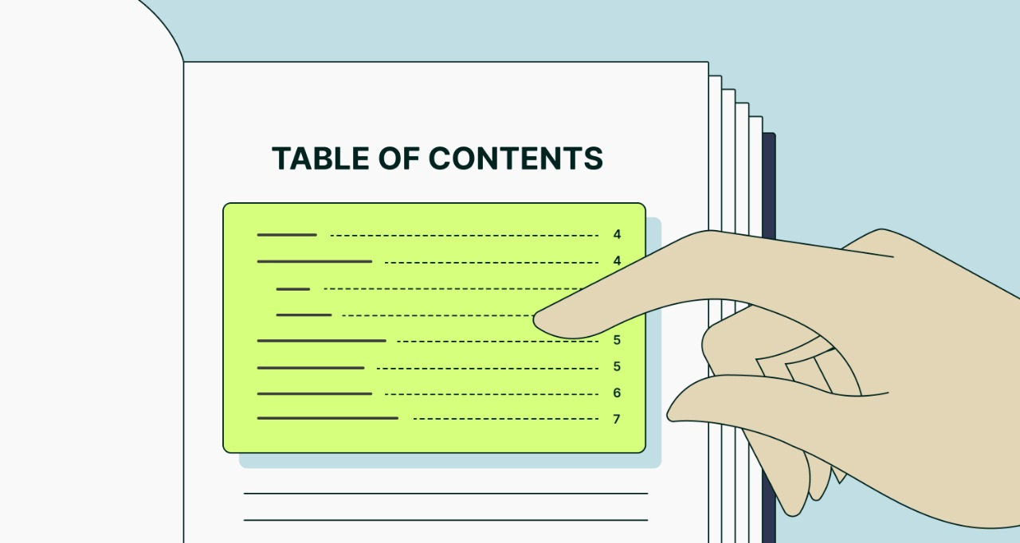
Table of Contents
1. Introduction
2. Problem Statement
3. Methodology
4. Source Code
5. Real-life Working
6. Future Scope
7. Conclusion
8. References

Slide 3



Problem Statement
To develop a machine learning model that predicts the win probability of teams competing in Indian Premier League (IPL) cricket matches based on ball-by-ball data from 2008 to 2022. Using historical match data,that includes ball-by-ball information, team performance metrics, match venue, player statistics, and match-specific factors. The goal of the model is to accurately estimate the likelihood of each team winning a particular match.

Slide 4

Methodology
1
Data Loading and Summary Checking
2
Data Cleaning
3
Feature Extraction
4
EDA and Data Visualisation
5
Best Player Clusters since 2008 based on Performance
6
IPL Match Winning Prediction 🏆

Slide 5
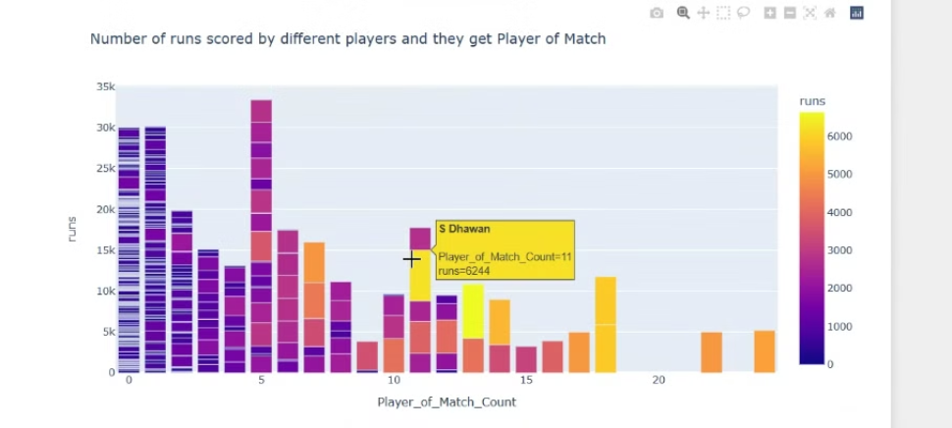
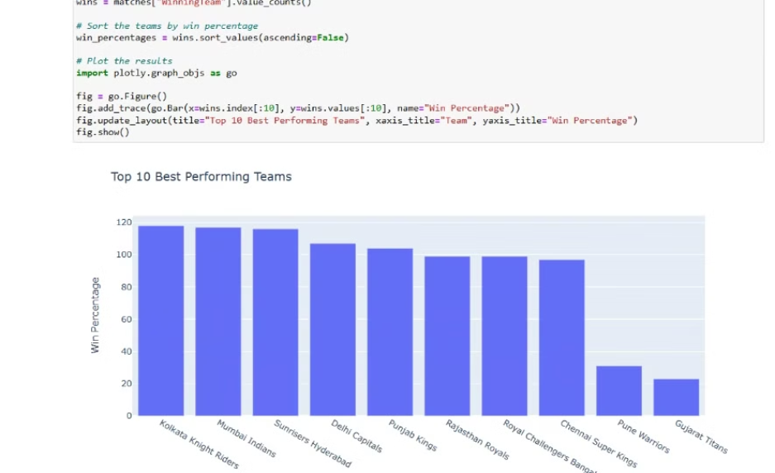
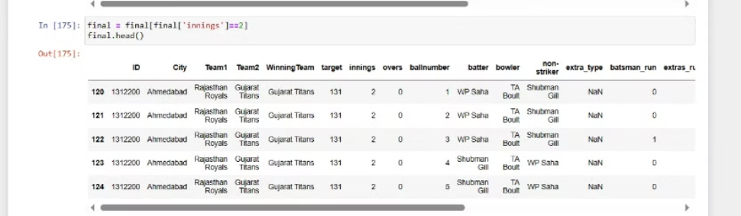
Source Code

Slide 6
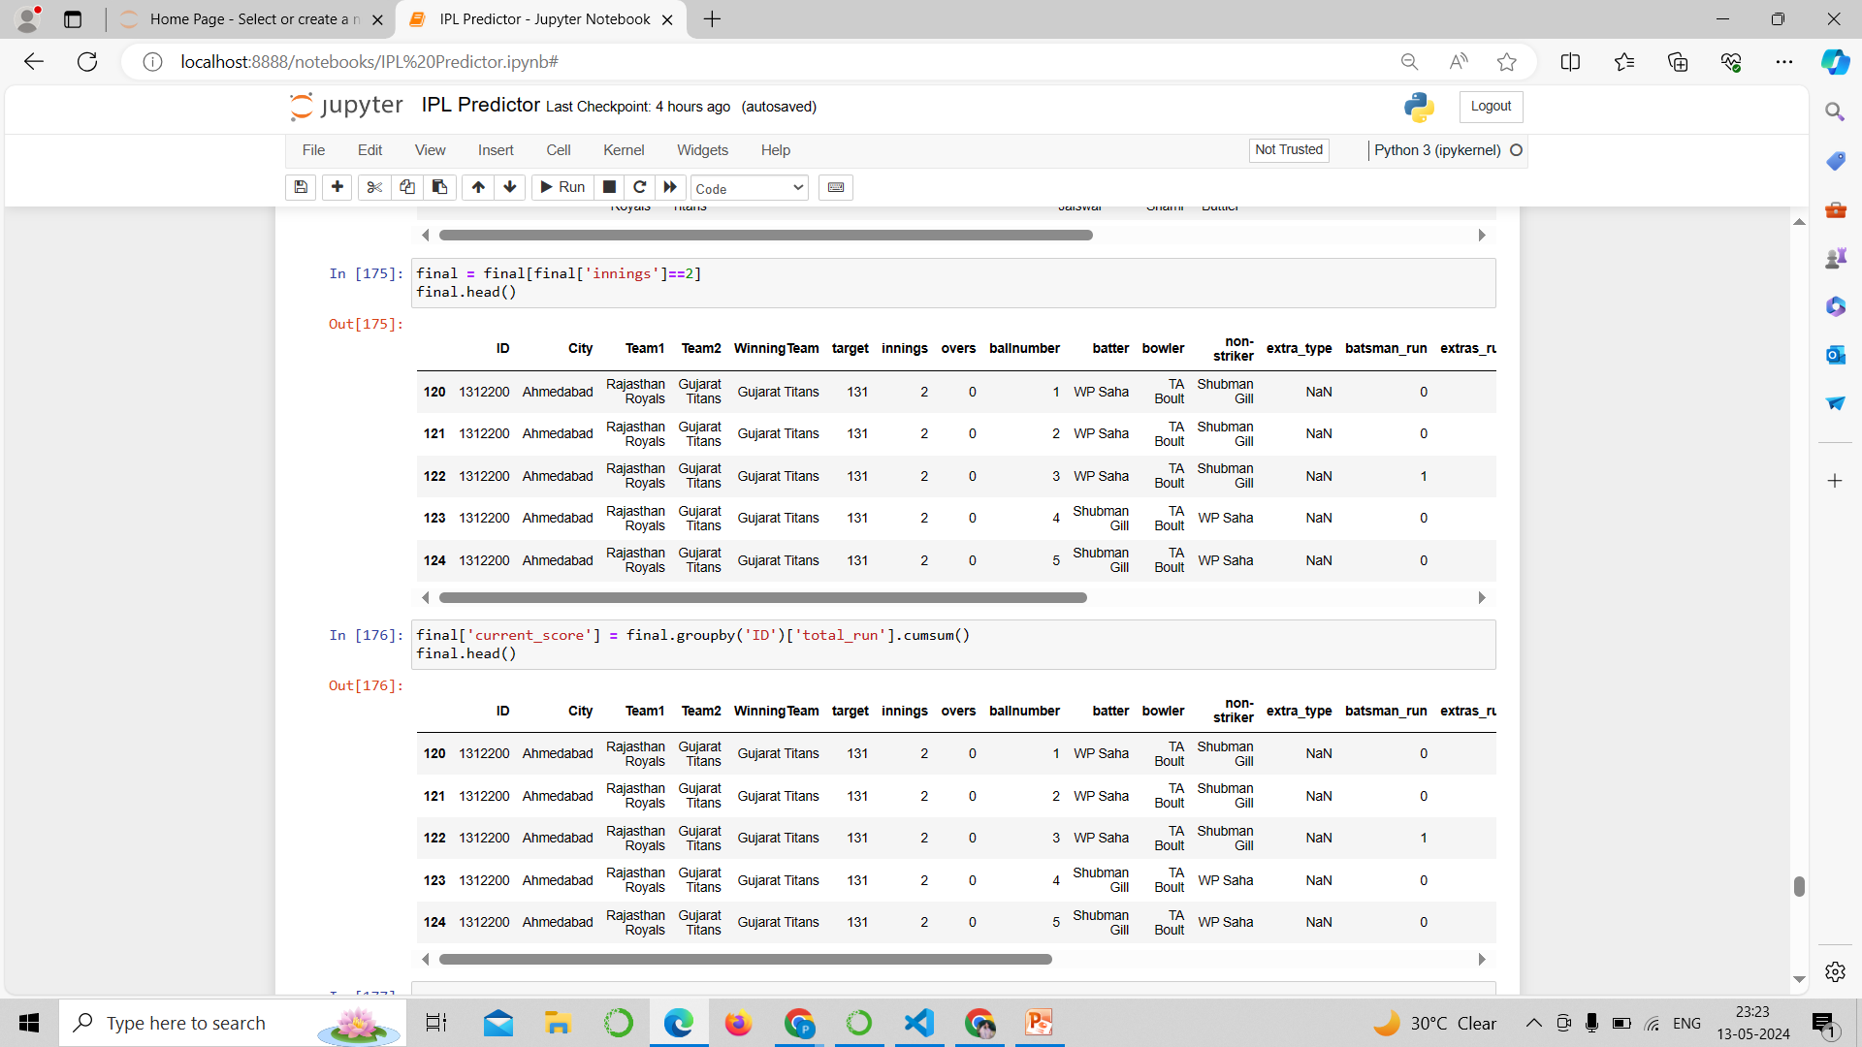
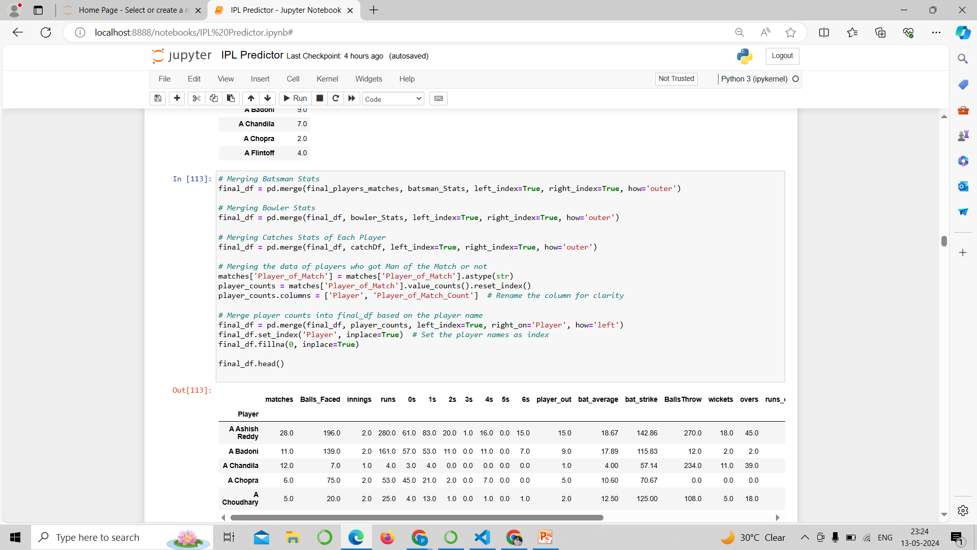
Source Code

Slide 7
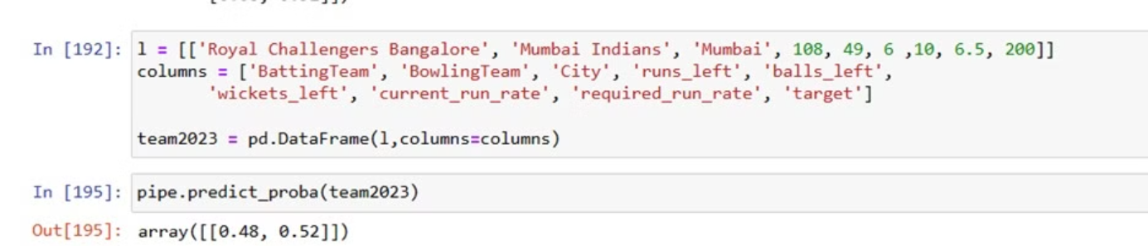
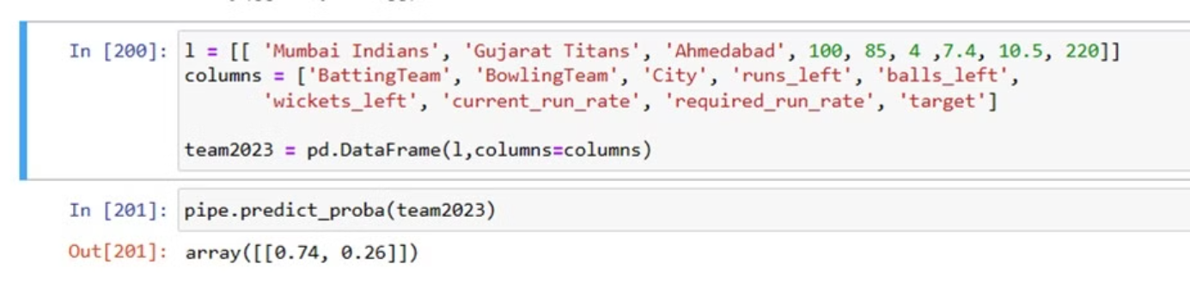
Real-life Working

Slide 8


Future Scope
Enhanced Predictive Accuracy
Utilize advanced AI techniques to further improve the accuracy of win probability predictions.
Real-time Data Integration
Integrate real-time match data for dynamic and instantaneous win probability updates during matches.
Player Performance Analysis
Enhance the model by incorporating detailed player performance metrics to refine predictions.
Incorporating External Factors
Explore the integration of external factors like weather and pitch conditions for more comprehensive predictions.

Slide 9


Conclusion
Skills Development
Data Analysis Insight
Algorithm Exploration
Domain Understanding
Problem Solving
Future Directions

Slide 10



References
DATASET ————→ https://github.com/simranjeet97/IPL2023_WinningPrediction_EDA_Dashboard/tree/main/IPL2023_Data
PROJECT IDEA ————→https://www.geeksforgeeks.org/machine-learning-projects/
Google———→https://www.google.com/
Geeks 4 Geeks ———>https://www.geeksforgeeks.org/

Slide 11



